Slide 1
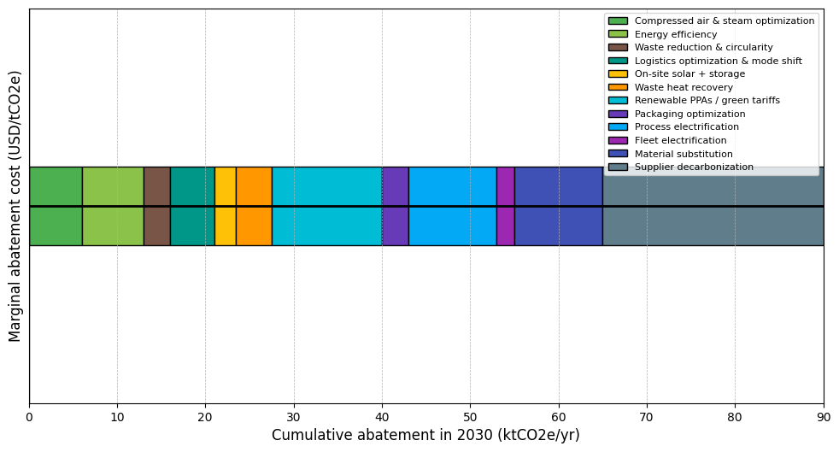
Abatement Levers and MAC Curve
Summary: Twelve prioritized levers deliver 90 ktCO2e/yr abatement by 2030; 62% of volume is cost-saving or near-zero cost.
Energy efficiency (motors, VFDs, HVAC & lighting): Scope: 1 & 2, Abatement 2030: 7 ktCO2e, Cost: -50 USD/t, Start: 2024, Full effect: 2026
Compressed air & steam optimization: Scope: 1, Abatement 2030: 6 ktCO2e, Cost: -70 USD/t, Start: 2024, Full effect: 2025
Process electrification (boilers, ovens, dryers): Scope: 1 & 2, Abatement 2030: 10 ktCO2e, Cost: 15 USD/t, Start: 2025, Full effect: 2030
On-site solar + storage: Scope: 2, Abatement 2030: 2.5 ktCO2e, Cost: -5 USD/t, Start: 2025, Full effect: 2026
Renewable PPAs / green tariffs: Scope: 2, Abatement 2030: 12.5 ktCO2e, Cost: 5 USD/t, Start: 2025, Full effect: 2027
Waste heat recovery: Scope: 1, Abatement 2030: 4 ktCO2e, Cost: 5 USD/t, Start: 2026, Full effect: 2029
Fleet electrification (yard/LDV): Scope: 1, Abatement 2030: 2 ktCO2e, Cost: 20 USD/t, Start: 2025, Full effect: 2029
Logistics optimization & mode shift: Scope: 3, Abatement 2030: 5 ktCO2e, Cost: -10 USD/t, Start: 2024, Full effect: 2026
Supplier decarbonization (SBTi/EPDs): Scope: 3, Abatement 2030: 25 ktCO2e, Cost: 30 USD/t, Start: 2024, Full effect: 2030
Material substitution / recycled content: Scope: 3, Abatement 2030: 10 ktCO2e, Cost: 25 USD/t, Start: 2025, Full effect: 2029
Waste reduction & circularity: Scope: 3, Abatement 2030: 3 ktCO2e, Cost: -25 USD/t, Start: 2024, Full effect: 2025
Packaging optimization: Scope: 3, Abatement 2030: 3 ktCO2e, Cost: 10 USD/t, Start: 2025, Full effect: 2027

